Slide 1

E-Commerce Database Management System Project
Presented by-
Kshitij Raj
Rutwik Mulay

Slide 2
Administrator’s Entry
Manage and view order information
Manage and view Product information based on managing products and categories
Manage and view shipping information based on managing payment methods, shipping types and ship areas

Slide 3
Customer’s View
Entry
Create an account (store and update account info, billing, shipping, and payment info)
Log in and logout functions
Manage shopping cart (add/remove products and change quantity)
Checkout

Slide 4
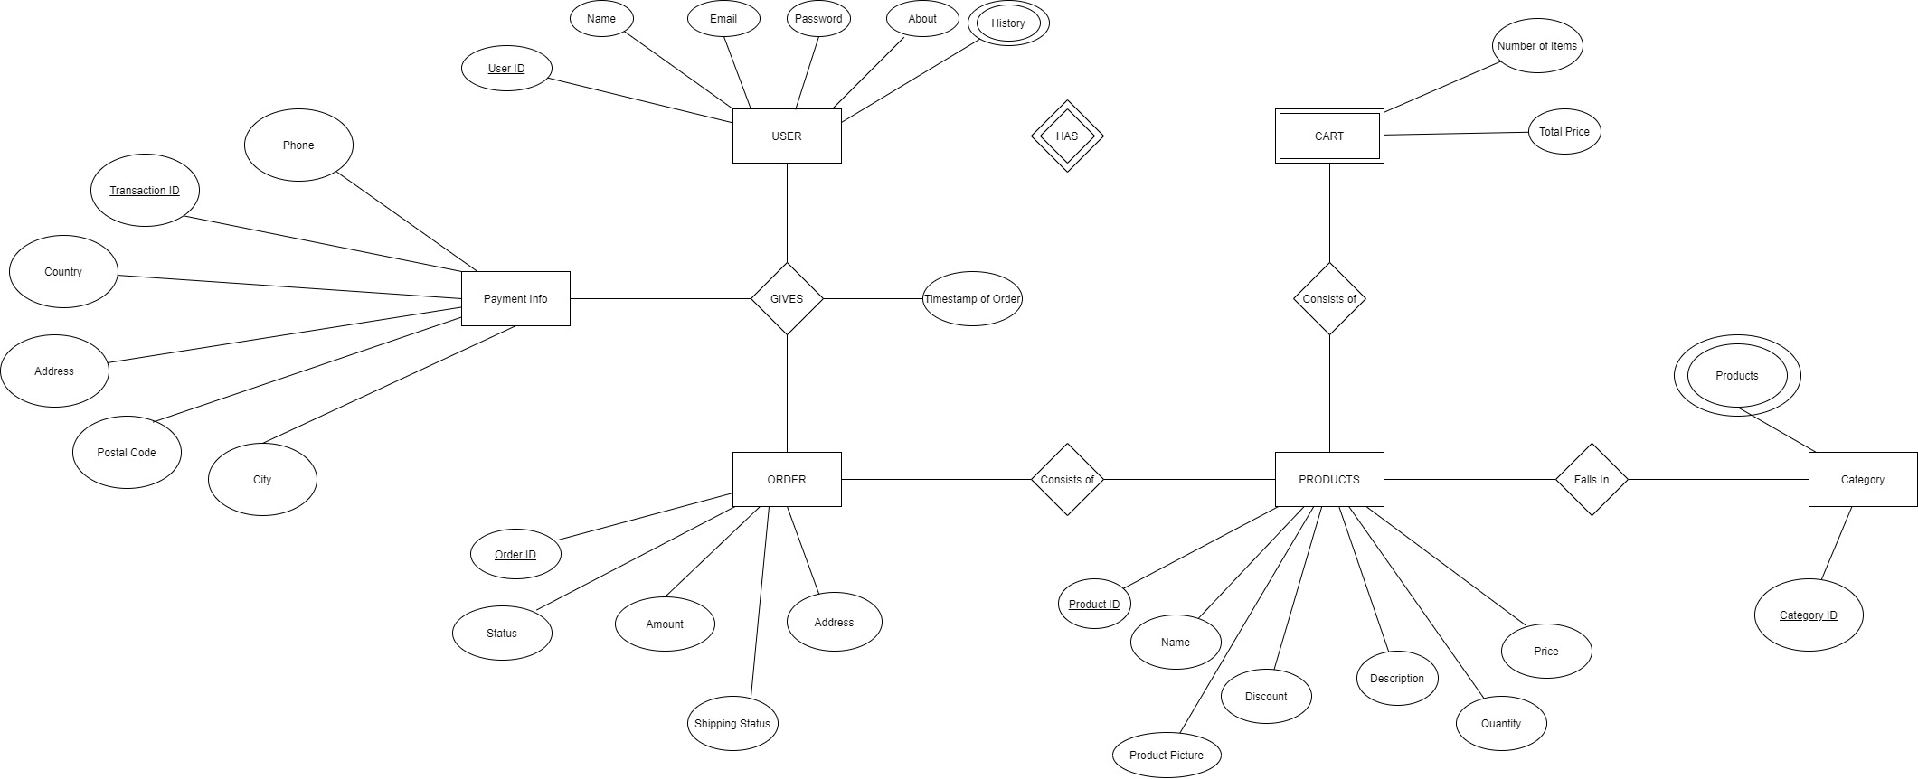
ER Diagram

Slide 5
Following are some of the important required tables of the SCHEMA
USER
PAYMENT INFO
ORDER
PRODUCT

Slide 6
Table for User
UserID | Name | Email | Password | About
Primary Key | Not Null | Unique | Not Null | No Constraints

Slide 7
Table for PAYMENT INFO
Transaction ID | Phone | Country | Address | City | Postal Code
Primary Key | Unique and Not Null | Not Null | Not Null | Not Null | Not Null

Slide 8
Table for ORDER
Order ID | Amount | Address | Status | Shipping Status
Primary Key | Not Null | Not Null

Slide 9
Table for PRODUCT
Product ID | Name | Price | Description | Discount | Quantity | Product Picture
Primary Key | Not Null | Not Null | Not Null

Slide 10
THANK YOU

